Slide 1
Treaty of Versailles Roles Play and OPVL

Slide 2
O - origin
Just copy down the line above the Source.
e.g. An extract from Stalin's Speech to the workers at the train station, 1932
If its a picture - the subtitle/caption thing usually is it)

Slide 3
P- purpose
Who its to, what it is (a speech? a propaganda pictures to urge..etc )
Try to find the theme of the message, was it to motivate the train workers? Was it to declare how great the Five Year Plans were doing?

Slide 4
V- value
Always refer to the O and P
So if the origin was an extract from Stalin's speech, then one value would be:
Its the exact words of Stalin, and gives us an idea of what he wanted, etc
Never ever use words like biased, useful etc. Instead us terms such as this source is valuable to a historian studying Communism under Stalin etc.

Slide 5
L- Limitation
It’s usually linked to the Origin and purpose.
Is the source limited because it was just a propaganda effort by Stalin?
Is the (book) source limited in its information because it was written before the Soviet archives opened in 1995?
Limitation could be: it is a biased speech because Stalin is trying to persuade workers to etc..

Slide 6
Take out a piece of paper….
I would now like for you to complete an OPVL for the reading we had today.
Take your time and think about what we talked about today.

Slide 7
Role Play
Need to divide class into 4 Groups: France, Britain, America, and Germany.
Groups 1-3 need to look at the issues presented below and decide their standpoint on each one.
Each group will then present to the class their ideas for what they believe should happen.
Even though Germany did not have a representative at the Versailles Conference, Germany will have an opportunity to respond to the decisions made today.

Slide 8
Points the delegates need to address:
Look at the map on the next slide, what decisions should be made concerning each of these areas.
Germany’s armed forces, are they going to be limited? If so, how?
Germany’s colonies, should Germany lose them? Why? What should happen to them?
Should Germany pay reperations? What damages, losses or penalties are these reperations to cover?
Will you make Germany guilty for starting the war? Why?
What other restrictions, if any, would you place on Germany?

Slide 9
Opening statement
At the start of your countries presentation, you need to give a speech giving an overview of your country's views regarding the war and any peace settlement, their impact the war has had on your country, and your views on Germany’s responsibility.

Slide 10
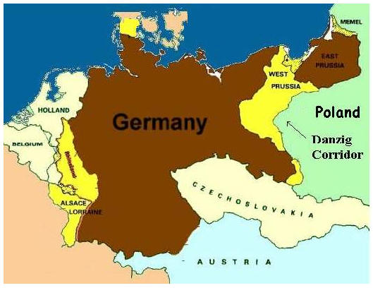
Disputed Lands
Alsace-Lorraine – Important industrial area claimed by France.
Saar – Coal-rich area claimed by France but with a large German population.
Eupen/Malmedy – Coal/iron rich area claimed by Belgium.
Rhineland – populated by Germans, but claimed by France as a protected area.
Schleswig – German since 1860s, but claimed by Denmark and mixed with Danish and German population.
West Prussia – German-speaking areas claimed by Poles, who wanted access to Baltic Sea.
Danzig – German-speaking port city claimed by Poland.
Memel – Claimed by Lithuanians, but predominantly ethnic German.
5.
8.
7.
6.
3.
2.
4.
1.

