Slide 1
Deviance and Social Control
Chapter 7

Slide 2
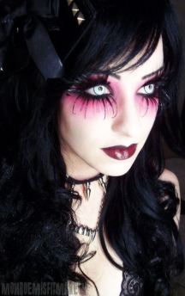
What is deviance?
Deviance – behavior that departs from societal or group norms.
Criminal Behavior - Wearing too much makeup
Deviance is subjective

Slide 3
Current Social Issues
Name things that people become obsessed/Addicted to.
Do you consider people with these addictions deviants? Why/not?
Does society accept some addictive/obsessive behaviors and not others.
Why do you think that is?

Slide 4
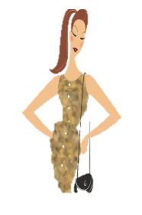
Types of Deviance
Negative Deviance – involves behavior that underconforms to accepted norms.
Positive Deviance – involves behavior that overconforms to social expectation.
Deviant – the person who breaks significant societal or group norms.
Negative
Positive

Slide 5
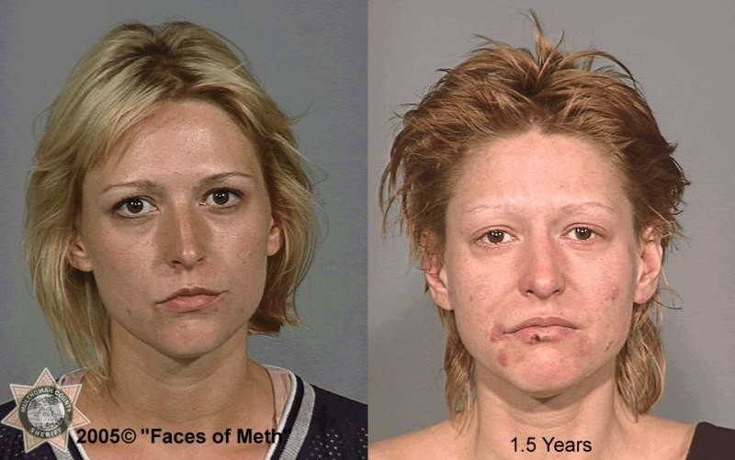
Positive or Negative

Slide 6
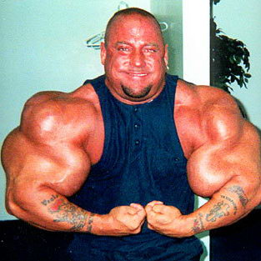
Positive or Negative

Slide 7
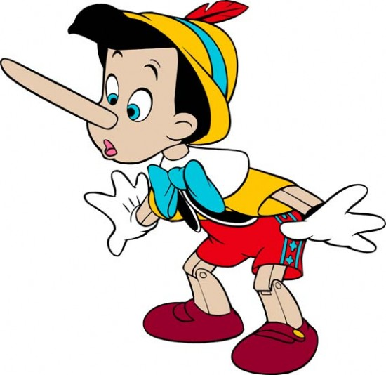
Positive or Negative

Slide 8
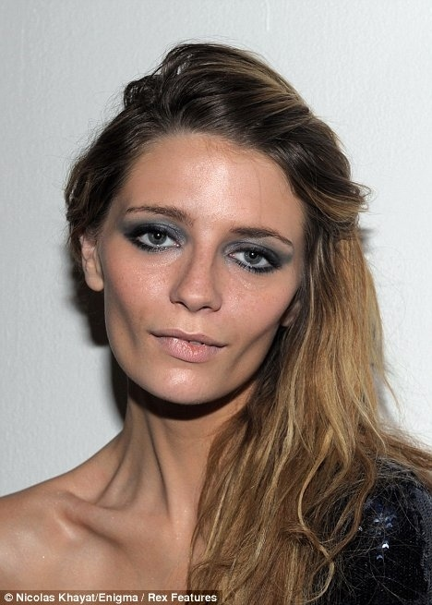
Positive or Negative

Slide 9
Social Control
All societies have ways to promote order, stability, and predictability in social life. This is done through social control.
Social control – ways to encourage conformity to societies norms.

Slide 10
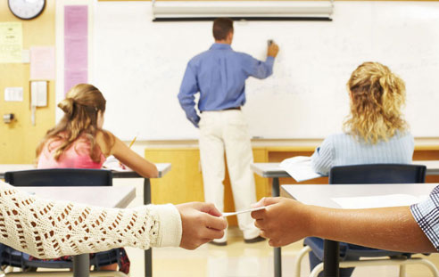
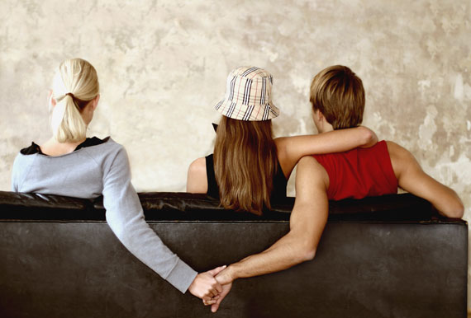
Two types of social control
Internal Social Control:
    Lies within the individual
  Do or don’t do something because:
    You think its wrong
    You think its right
    Afraid of consequences

Slide 11
Two types of social control
External social control is done by the society not the individual.
Uses social sanctions to maintain peace.
Social Sanctions – rewards or punishments that encourage conformity to social norms.
Positive:
  Good grades
  Allowance
  Promotions
  Smiles of approval
  Awards
Negative:
  Criticism
  Fines
  Imprisonment
  Bad grades
  Finger waving

Slide 12
Video Clip
Intro – watch x2
What to look for:
  Examples of deviance to 1950’s American Society.

Slide 13
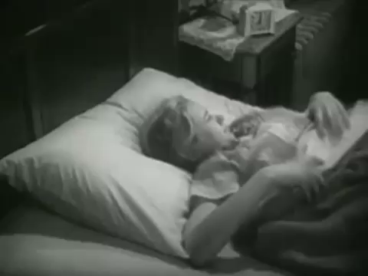

Slide 14
Video Clip
Intro – watch x2
What to look for:
  Examples of deviance to 1950’s American Society.
  How is this society different/similar to the society you live in?

Slide 15
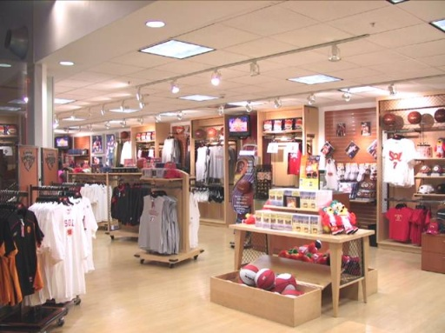
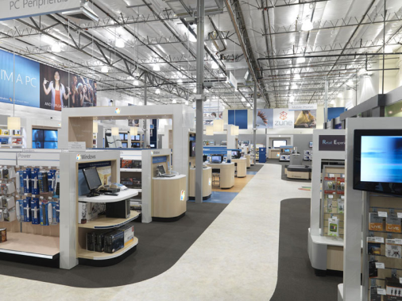
Journal #28
For next class
  Visit or think of a retail store: clothing, shoe, carpet etc.
  What internal means of control are used to prevent theft in stores?
  What external means of control are being relied upon?
  Be prepared to share your findings/ideas with the class next time we meet.

