Slide 1
OPVL

Slide 2
Diary Entry
This diary was put together by Lt. Edwin Jones who experienced many of the privations of the campaign. It provides a unique glimpse into the everyday life of a junior officer at the time.
December 23rd 1915
Still at sea and all going on splendidly; everybody happy, but of course, food very scarce.
Bombegy, our Indian cook, was very worried owing to the shortage of rations and we all so hungry, almost threatening him that we should cut him up for stew as a last resource. As usual, the "Sanitary Men" are called for duty, and we started 5 a.m. disinfecting the ship and horse lines. It was hard work, but we did it with a smile, a noted thing for "Sanitary Men".

Slide 3
Letters
Bert Cox served until June 28, 1919 for the Canadian Army.
We had a very quiet Xmas. We drew for passes and I got stung so I stayed at home and looked after the horses. The army gave us a good dinner though, even potatoes cooked without skins, fruit, plum pudding and cigars. Each one of us got a parcel from the Ladies Auxiliary of the 59th Battery. I pulled off a pair of socks, dish towel, and cigarettes.
Finished up the day by going to a concert in Godalming. We are going to Salisbury Plains tomorrow to have our final test in firing and hope to be in France in a few weeks.
Our gun the 18 pounder, is not effective against infantry in trenches, the trajectory of the shells is too flat. (Howitzers are used for this purpose), but is used against infantry advancing, or for purposes of destruction to buildings etc.
The Headquarters Party Chief work, at the front, is with the telephone, as means of communication, and is of greatest importance in this war. I might be the telephonist for the Forward Observing Officer, almost in the 1st line trenches of the Infantry, we are supporting, or might be at the battery, on either of the other 6 phones.

Slide 4
Speech
Speech of Wilhelm II to the Guards at Potsdam, August 18, 1914
……The sword is drawn, and I cannot sheathe it again without victory and honor. All of you shall and will see to it that only in honor is it returned to the scabbard. You are my guaranty that I can dictate peace to my enemies. Up and at the enemy! Down with the enemies of Brandenburg! Three cheers for our army!

Slide 5
Official Government Document
Excerpt from
British Documents on the Origins of the War
The End of British Isolation

Slide 6
Historical Text
A passage from an IB course book and the Paris Peace Conference.

Slide 7
Biography
An excerpt from the biography of a German military leader during WW1.

Slide 8
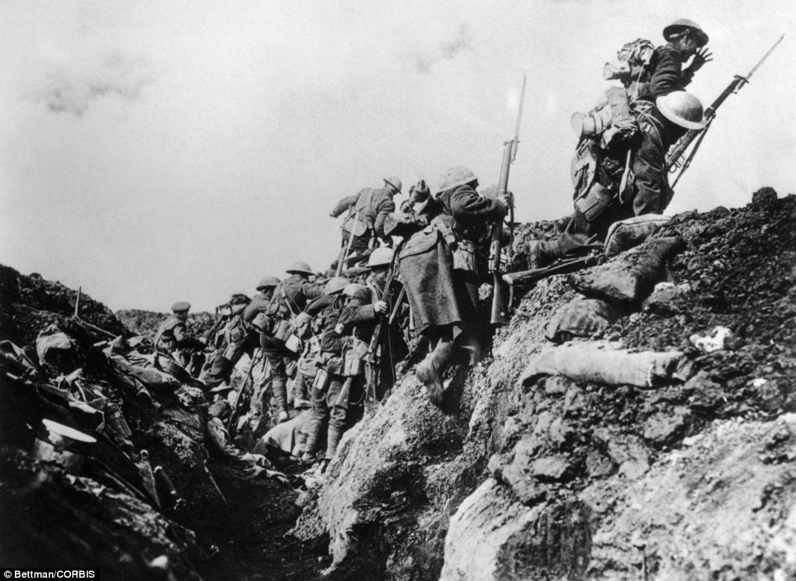
Photograph

Slide 9
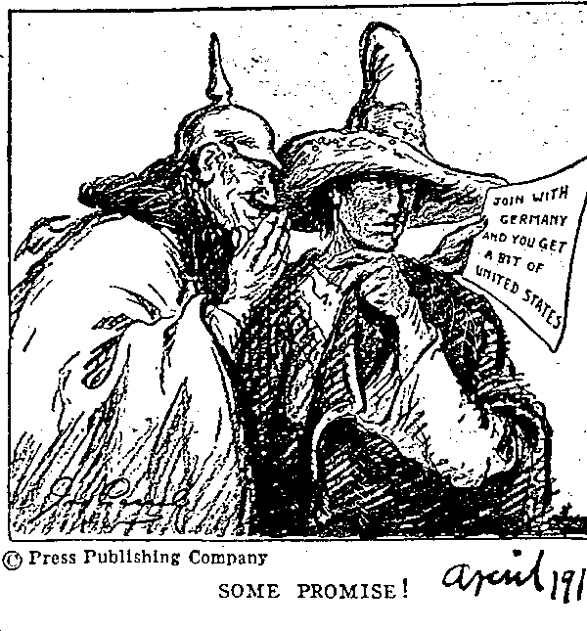
Cartoon

Slide 10
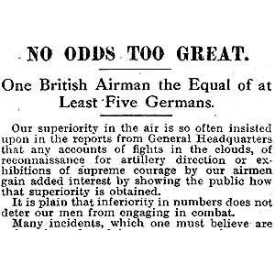
Newspaper Article

