Slide 1
Unit 2: World War I
Lesson 5: WWI and the Western & Eastern Fronts

Slide 2
The Deadlock on the Western Front
The Failure of the Plans
The Schlieffen Plan
Background
Created by General von Schlieffen in 1905
Assumptions
war would be on two fronts against France and Russia
Russia would be slow to mobilize
Britain would remain neutral
Based on the use of railways to move troops
Plan’s Design
Swift knock-out blow to France in the west through neutral Holland, Belgium and Luxembourg
Capture of Paris
Encirclement of French armies attacking Alsace-Lorraine
Defeat of France within six weeks.
Transfer of German troops east to fight Russia

Slide 3
The Schlieffen Plan cont.
Failure of Schlieffen Plan and the stalemate
British Expeditionary Force of 120 000 soldiers lands in France and delays the German advance at Mons, Belgium.
Russia mobilizes faster than expected and some German soldiers are withdrawn from Belgium to fight in the east.
French plan to invade Alsace-Lorraine fails and the soldiers are sent to prevent the German invasion. (known as Plan XVII)
Because of the greater resistance and the withdrawal of soldiers to the eastern front, Germany changes its plan to go east of Paris rather than west making it less effective.
French and British troops stop the German advance at the River Marne and the Germans retreat 60 kms and build trenches.
Both sides race to the sea in an effort to outflank each other.
Result: Trench systems stretch from the coast of the English Channel to the border of Switzerland at the end of 1914.

Slide 4
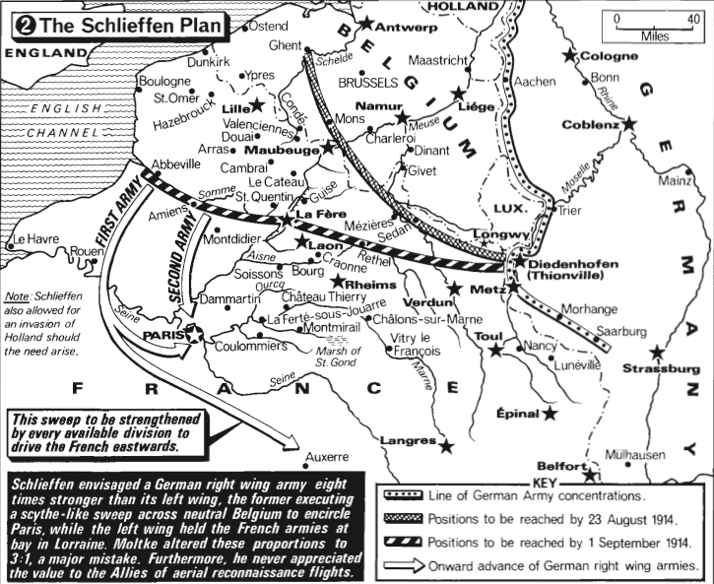
The Schlieffen Plan

Slide 5
The Schlieffen Plan

Slide 6
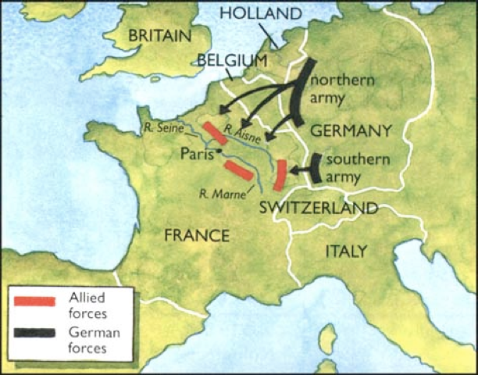
Battle of Marne 1914

Slide 7
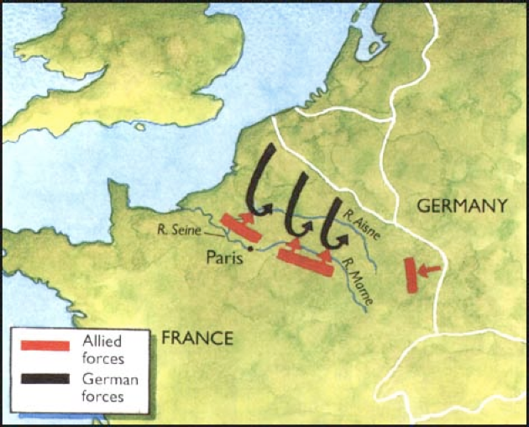
Battle of Marne 1914

Slide 8
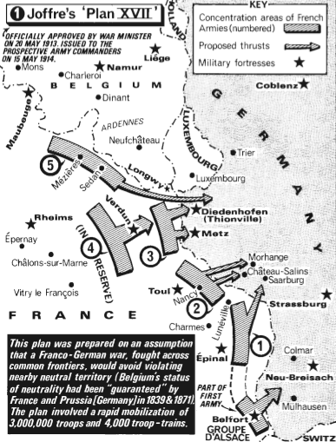
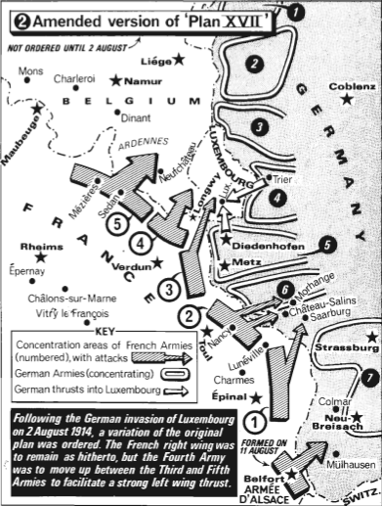
The Failure of the Plans cont.
Plan XVII
Designed to regain the lost territories of Alsace-Lorraine and avenging the humiliating defeat of 1871.
Stressed the enthusiasm of the offensive spirit and underestimated German defenses, which led to its failure.
Played into the Schlieffen Plan’s expectations

Slide 9
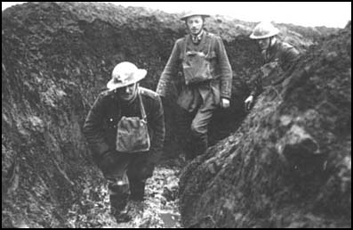
The World of the Trenches
Trench lines
Characteristics
Front line was dug in a zig-zag pattern
Wooden boards covered the bottom of the trench and a “fire step” was used for observing and shooting.
Lines included machine gun nests, mortar batteries, and concrete pill boxes
Behind the front line were many other lines: support lines, reserve lines, and retreat lines
Maps or guides were required to navigate
Bunkers were built to house up to a dozen men
Behind the lines were heavy artillery positions
Weather made the front line trenches especially wet and sometimes they were flooded. The mud made it difficult to move across the landscape.

Slide 10
Trench lines Characteristics cont.
Rats and vermin were found in abundance
Trenches were separated by about 275 yards of no-man’s land. In some areas, no-man’s land was narrower.
Life in the trenches included a lot of boredom, but also short moments of absolute horror.
Robert Graves remarked in his book, Goodbye to All That: "Rats came up from the canal, fed on the plentiful corpses, and multiplied exceedingly. While I stayed here with the Welch, a new officer joined the company and, in token of welcome, was given a dug-out containing a spring-bed. When he turned in that night he heard a scuffling, shone his torch on the bed, and found two rats on his blanket tussling for the possession of a severed hand." - http://www.spartacus.schoolnet.co.uk/FWWrats.htm

Slide 11
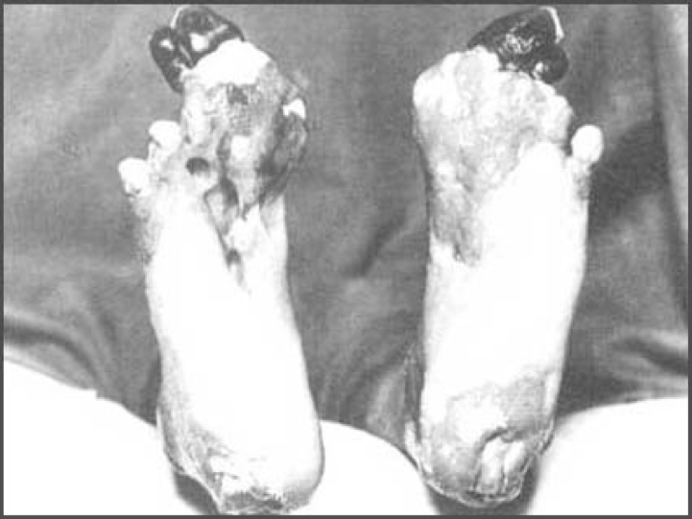
Trench Foot

Slide 12
Primacy of Defense
Massive artillery barrage would be used with the intent of damaging the enemy and making attack easier.
Artillery barrage led to the loss of surprise
After the barrage, attacking troops would go “over the top” with fixed bayonets and advance through no-man’s land and into enemy trenches
As the barrage had torn up the ground, it was difficult to advance and easy to get lost.
Barrages rarely worked: wire remained uncut, defenders waited in the safety of deep bunkers. German machine gunners could be back in position in three minutes at the Somme.
Defenders could use railways to move up reinforcements, but attackers had to advance slowly on foot.
AJP Taylor: “defence was mechanized, attack was not.”

Slide 14
Great Battles of Attrition
Battles on the western front showed the senseless mass death of the Great War
Verdun, 1916: 700,000 French and German casualties with 300,000 dead (one dead each minute)
Somme, 1916: 400,000 British casualties
Passchendaele, 1917: 325,000 British casualties
Hastened the search for ways of breaking the deadlock through technology, opening other fronts, etc.

Slide 16
The Eastern Front
“Unknown War” – title of Winston Churchill 1931 history of the Eastern Front
Differed from the Western Front with its greater mobility and its outcome
Russian advance
Russian army moved west into German territory as German officials prepared to evacuate eastern Prussia
Germany sent Colonel-General Paul von Hindenburg and Chief of Staff Major-General Erich Ludendorff to the eastern front.

Slide 17
The Eastern Front
Tannenberg
German forces intercepted Russian wireless messages, giving valuable clues to Russian plans.
German forces were able to surround the Russian army and beat it.
Russian General Samsonov shot himself in despair.
Germany won again against the second Russian army at the Masurian Lakes
German advance
Pushed Russian armies back 300 miles before the front stabilized again, conquering present day Poland, Latvia, and Lithuania.
Russians were almost out of the war with 2.5 million casualties.
Tsar Nicholas II took control of the Russian army and thus would be personally blamed for any failures. (Sept. 5, 1915)

Slide 18
The Eastern Front
Brusilov Offensive
Last Russian offensive directed at Austria-Hungary
Russia took 250,000 Austria-Hungarians prisoners
This success led Romania to join the Triple Entente.
The Brusilov offensive broke down because he did not receive enough support from the north (had 1 million casualties.)
The Russian army was in disintegration and by March, 1917 Russia was experiencing revolution at home.

Slide 19
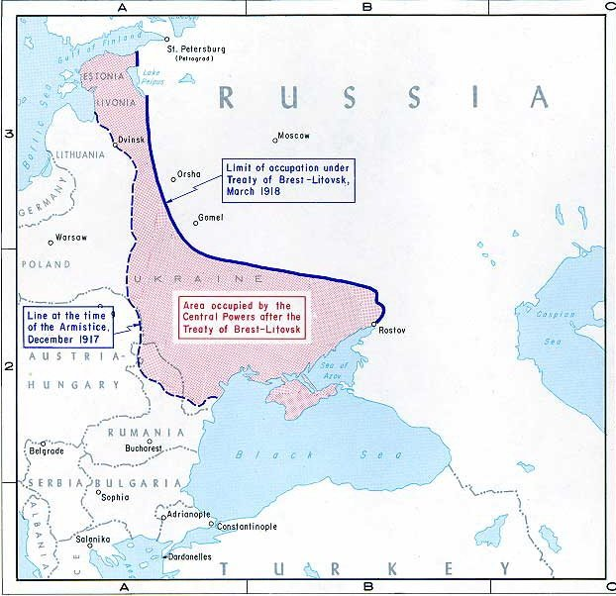
The Eastern Front
Treaty of Brest Litovsk (March 3, 1918)
Russia was forced to sign this peace treaty
Russia lost 1/3 of its European land; ½ of its industrial capacity; the loss of Ukraine’s grain was also harsh.

