Slide 1
The Urban Transition
Chapter 16 Section 3

Slide 2
Defining a City
When does a village become a city?
Depends upon your society:
Denmark and Sweden – 200 people and up
US – 2,500 and up
Japan – 30,000 and up
This set amount of people is not all it takes to be defined as a city.
Our book defines a city as: a dense and permanent concentration of people that mostly work nonagricultural jobs.

Slide 3
Urbanization
Urbanization – process by which an increasingly large portion of the world’s population live in or near cities.
This is a relatively new development in our history.
According to historians, in 1800, London was the only city with a population of a million people.
Why do you think this is?
Transportation and transportation of goods are largely dependent on power:
First human power
Then horse, camel, dog, oxen, reindeer or other animals
Once coal, oil, and natural gas replaced muscle power cities began to expand rapidly.

Slide 4
Urbanization and Industrialization
The Industrial Revolution created changes in transportation, agriculture, commerce and industry.
How do these impact urbanization?
This provided farm workers the opportunity to move to and work in factories instead.
This intern attracted retailers, innkeepers, entertainers, etc.
This lead to a cycle, more people, more goods offered, more attractive cities become for more people.
So now instead of one city in the world with over a million people in 1800, in the year 2000 there were hundreds of cities bigger than London.

Slide 5
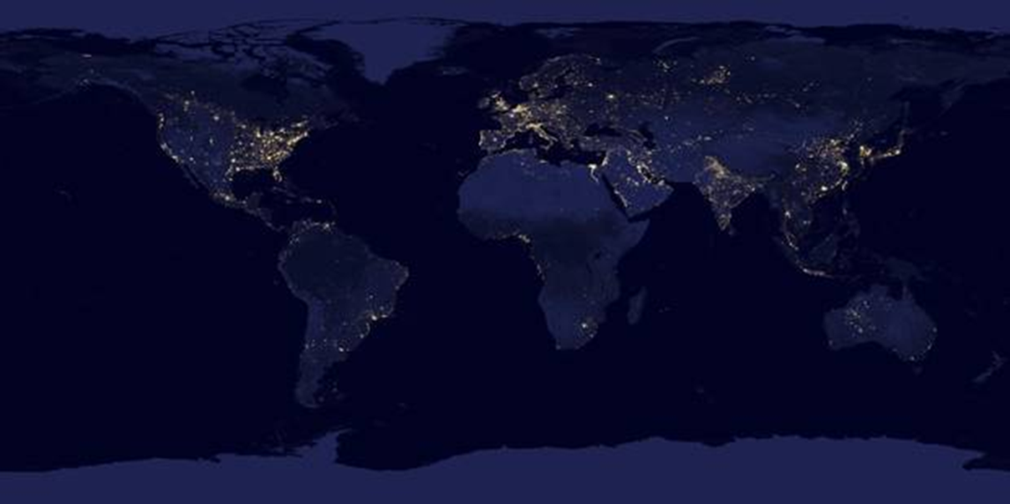
World Urbanization
From 1800 to the mid 1980’s:
Total population has increased 5x’s
Number of urban dwellers has increased over 100x’s!
In developed countries 76 percent of population live in urban areas, 41 percent in less developed.

Slide 6
Push/Pull Factors of Urbanization
What are some of the ‘push’ factors that lead people to move to urban areas?
What are some the ‘pull’ factors that people move to the urban areas?

Slide 7
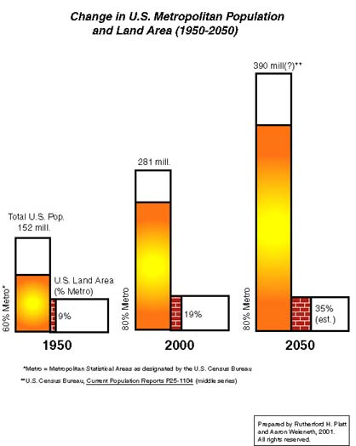
How has the percentage of the US population increased from 1950?
How will land area covered by metro areas according to the graph?
With urban ecosystems changing how will the way they function change?
What might some of these changes be?

Slide 8
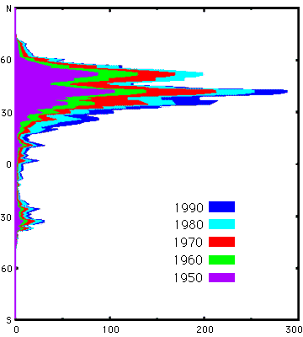
Problems with Urbanization
Overurbanization – city cannot supply enough jobs for the people who occupy it.
Central-city dilemma – people need public services (school, transportation, health-care) but don’t have the money to fund it (think inner-city)
Rise of pollution:
Latitudinal distribution of decadal carbon emission data. Horizontal units are 10⁶ metric tons.

Slide 9
Assignment
Write a "letter to the grandkids"—that is, the people who will be sitting right here in this classroom in 50 or 70 years.
The letter should explain, in plain English, what you learned about global population trends as well as urban population trends.
The letter should also tell the grandkids how important fossil fuels were to the growth of cities and how the signal of fossil fuel use showed up in the atmosphere.
Will your grandkids be using fossil fuels in 2050 or 2070. If not, what might power the cities?

