Slide 1
The Locarno Era
Causes of WWII

Slide 2
Ruhr Aftermath
Following the Ruhr the political environment actually showed signs of improvement.
Factors included:
The Dawes Plan
Locarno Pact of 1925
The Kellogg-Briand Pact of August 1928
The Young Plan of 1929
Important to note that all of these major agreements took place outside of the League of Nations.

Slide 3
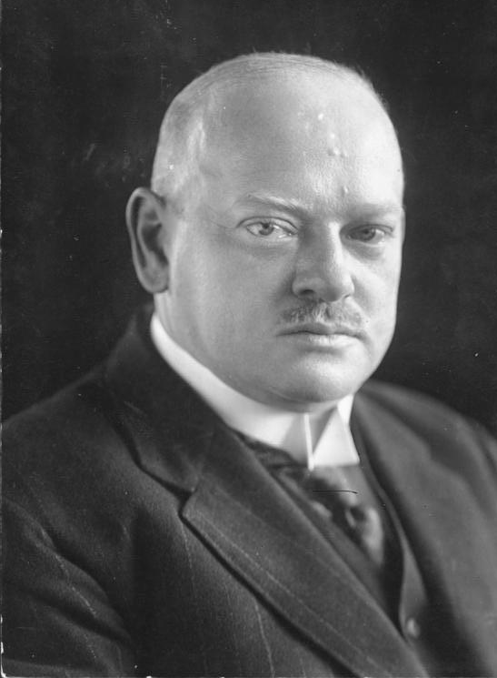
Gustav Stresemann
Stresemann was appointed chancellor of Germany.

Slide 4
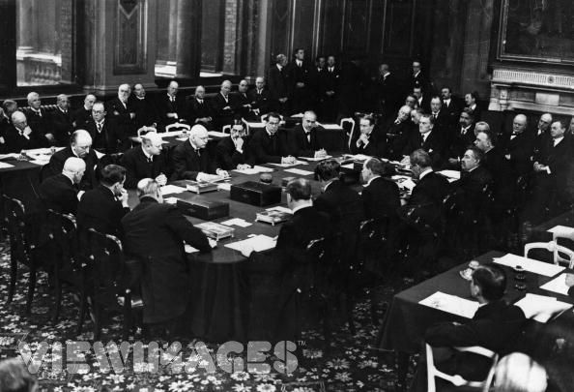
Locarno Conference
Conference held in Locarno, Switzerland.
Countries involved in conference included:
Germany
France
Belgium
Italy
Czechoslovakia
Poland

Slide 5
Locarno Conference
Although French forces left the Ruhr, there were still allied troops in the Rhineland per the Treaty of Versailles.
At this time there were no agreement as to what should be done with the lands between France, Belgium and Germany.
There was even talk of an independent Rhineland
During conference Germany gave up its claims over Alsace-Lorraine.
In return Germany wanted assurance that France would not invade again and remove any potential for an independent Rhineland.
Finally the Locarno Conference agreed that Germany should be admitted into the League of Nations.

Slide 6
Locarno Video

Slide 7
Spirit of Locarno
The overall result of the Treaty was that of general optimism and a sense of euphoria “the Spirit of Locarno”!!
Tensions had been reduced, Germany had accepted its borders and renounced violence, prosperity was returning to Europe.
Democracy was flourishing in Germany.
Conference was followed up with a series of agreements involving the USA, this ‘spirit’ was involving even the isolationist nations.

Slide 8
Peace
There appeared to be progress towards peace and a new relationship between the Allies and Germany.
Germany joined the League of Nations and was given a permanent seat on the Council.
The Allies removed troops from the west bank of the Rhine and the Allied commission to supervise disarmament left in 1927.
In what other ways did the Locarno Conference mend relationships between countries?

Slide 9
Issues with Locarno
Germany accepted the results of WW1 in the west but not in the east or south.
This makes countries like Italy, Czechoslovakia, and Poland nervous
France changed its tactics in dealing with Germany.
Policy changed from force to diplomacy
Finally, once again France had sought security outside of the League, further weakening it.

Slide 10
5 min break

Slide 11
The Young Plan (1929)
The Young Plan attempted to redress some of the problems that remained with the Dawes Plan
The plan:
Further reduced the total sum to be repaid by Germany
Set a date for completion of repayments – 1988!
Continued US involvement in reparation repayments
Britain and France agreed to end their occupation of the Rhineland five years ahead of schedule
Both Dawes on Young Plan were based on foreign money.
Thus both German and European recovery was foreign money.
Two-thirds of investment in Germany during the 1920s came from America.
The reparation arrangements were ‘in the hands of American capitalists’.

Slide 12
Kellogg-Briand Pact (August 1928)
Pact initiated by American Secretary of State William Kellogg and French Foreign Minister Arstide Briand.
Pact renounced war as an instrument of national policy.
62 of 64 states signed the agreement (Brazil and Argentina declined)
Pact is seen as the high point of Locarno Spirit era.
However it could be argued that no major conflicts occurred due to:
Germany still recovering
A period of international economic boom.
“Europe had survived, but was still on the sick list.”

Slide 13
Kellogg-Briand Pact (August 1928)
The spirit of Locarno was best exemplified in 1928 with the signing of the Kellogg-Briand pact.
The pact was signed by 65 countries and they agreed by this action to renounce war as an instrument of national policy.
The work of Stresemann and Briand at Locarno was recognized when they were awarded the Nobel Peace Prize in 1926.

Slide 14
Paper 1 - Test
We will have a practice test on the Locarno Conference.
Remember Paper 1 is four questions: Compare and contrast, OPVL and a mini essay.
Take time to review all the Paper 1 test taking skills.

Slide 15
Key words – Study Guide
Locarno Conference
Aristide Briand
Austen Chamberlain (GB foreign minister)
Gustav Stresemann

