Slide 1
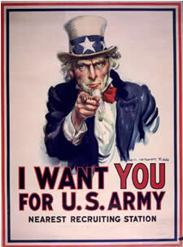
Topic 1: causes, practices and effects of war

Slide 2
20th Century Warfare
Different types of 20th Century warfare o Civil, guerrilla, limited, revolutionary o Total war
Origins and Causes of War o Long-term and short-term causes, failure of diplomacy o Economic, ideological, political, religious causes
Nature of 20th Century Wars o Technological developments, tactics and strategies: air, sea and land o The home front, the role of women o Resistance and revolutionary movements
Effects and Results o Treaties, and wars ending without treaties o Political repercussions, territorial changes o Social and cultural effects, changes in the status of women o Post-war economic problems

Slide 3
Type of 20th Century Warfare
From the following list, how you would categorize the warfare of WWI? Why?
Civil?
Guerrilla?
Limited?
Revolutionary?
Total?

Slide 4
Accepted Historical Perspectives on the cause of WWI:
Long term:
Balance of power: Germany and Italy upsetting the “old European” status quo.
Competition created by imperialism
Aging and putrid empires created chaos as they crumbled: Ottoman, Austrian, Russian

Slide 5
Accepted Historical Perspectives on the cause of WWI:
Long term causes continued:
England monopolizing the world’s finances
Alliance system which was set to default to war
German nationalism is the theory which was trumpeted after the war, but not before.

Slide 6
Diplomacy and Alliances
By 1900, a united Germany produced more steel than Britain and France combined.
Germany felt it needed and deserved “a place in the sun”.
German goods are sold, colonial competition begins and some countries look to the German Empire as a friend and protector.

Slide 7
Diplomacy and Alliances
The Triple Alliance:
In 1879 Germany enters into a military alliance with Austria-Hungary.
An alliance with Italy is added in 1882.
(This alliance ends before WWI)
To be safe, a “reinsurance” treaty is also signed with Russia.
(This alliance lapses over time)

Slide 8
Diplomacy and Alliances
In 1894 France forms an agreement with Russia. While the countries are different ideologically, France feels the pressure of the Triple Alliance.
By this time, Europe is divided in two camps:
German-Austrian-Italian
Franco-Russian

Slide 9
Diplomacy and Alliances
What about Britain?
Britain prided itself on a “splendid isolation”.
Begins to feel pressure by a growing German navy
Enters into a loose entente cordiale with France and Russia, but refused to make any military commitments.

Slide 10
Failure of Diplomacy
Germany encourages Moroccan independence in an attempt to break the Entente, which makes it stronger
Crisis in the Balkans as the Ottoman Empire crumbles: religious and political differences and begin to fuel unrest.
The result was two wars in the Balkans, in which Austria ultimately denied Serbian expansion to the sea.

Slide 11
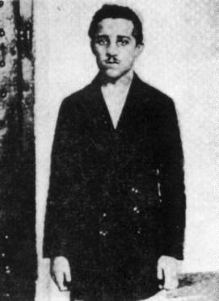
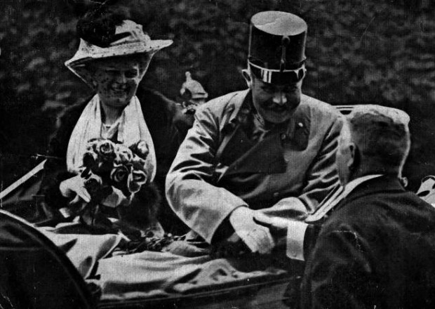
Short-term Causes
The Union of Death also known as The Black Hand assassinates Archduke Franz Ferdinand in Sarajevo.
Gavrilo Princip was the assassin who pulled the trigger.
Ferdinand’s last words:
“Sophie dear, Sophie dear,
don’t die! Stay alive for
our children!”

Slide 12
Short-term Causes
Events that followed:
Austria decides to crush Serbian independence.
Germany gives Austria a “blank check” and encouragement to be firm.
The Serbs counted on Russian support
The Russians in turn counted on France who were terrified to face a war with Germany alone, give a “blank check” to Russia.

Slide 13
Germany’s Blank Check to Austria-Hungary:
“In the meantime His Majesty desires to say that he is not blind to the danger which threatens Austria-Hungary and thus the Triple Alliance as a result of the Russian and Serbian Pan-Slavic agitation.”

Slide 14
Serbia’s Response to Austria-Hungary
(Preamble) ...[Serbia] cannot be held responsible for manifestations of a private character, such as articles in the press and the peaceable work of societies ... [The Serbian government] have been pained and surprised at the statements, according to which members of the Kingdom of Serbia are supposed to have participated in the preparations of the crime...

Slide 15
War Begins
Russia mobilizes it’s army to the German and Austrian boarders.
Germany demands an end to mobilization of troops, gets no answer and declares war on Russia on August 1, 1914.
Germany also declares war on France on August 3, 1914.
Britain declares war on Germany on August 4 only after neutral Belgium is invaded.

Slide 16
For you to consider:
The effects of alliances, international markets, industrialism, imperialism/colonialism and nationalism during this time period.
Other economic, ideological, political and religious causes of the war.
Was this war truly inevitable? Were there possible steps that could have been taken to avoid war?

Slide 17
Nature of 20th Century War: War on Land
The Schlieffen Plan:
Germany’s plan to use the excellent rail system to get troops quickly into France through Belgium and then turn “leisurely” to Russia.
During the Battle of the Marne, German troops are forced to retreat, France would not fall in a single blow.

Slide 18
Technology in war
Aviation was barely beginning
Motor transport was new, few tanks until late in the war
Poison, tear and mustard gas used
The most deadly weapon of the early war was the new machine gun, which made it impossible for soldiers to advance across open fields.
This resulted in a long stalemate in the trenches.

Slide 19
Trench Warfare
From autumn 1914-spring 1918
1/3 of all Allied casualties were sustained in trenches.
Rats--eating human remains could grow as big as cats. A single rat could produce 900 offspring a year.
Lice!
Trench Fever--severe pain followed by a high fever
Frogs, slugs and horned beetles.
Trench Foot-infection of the feet caused by the cold, wet and unsanitary conditions of the trenches.

Slide 20
Trench Warfare continued…
Patrolling the dangerous areas of no-man’s land (the area between trenches)
Boredom
The smell--rotting carcases, overflowing latrines, dried sweat, rotting feet, lingering odor of poison gas and other smells of cooking/daily life.

Slide 21
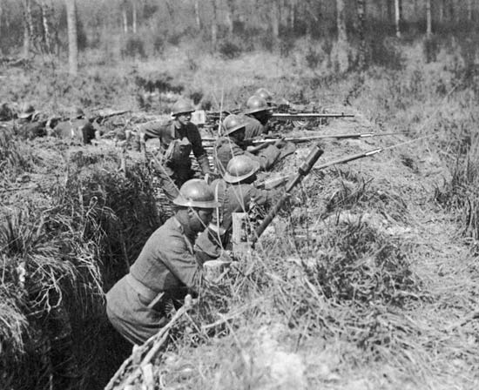

Slide 22
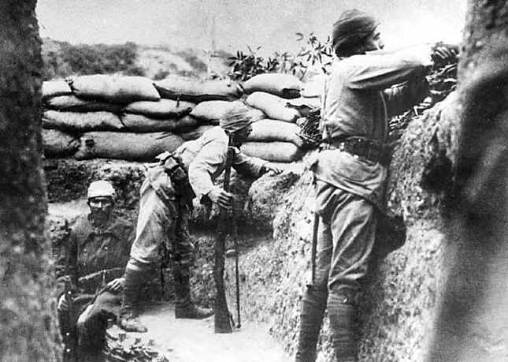

Slide 23
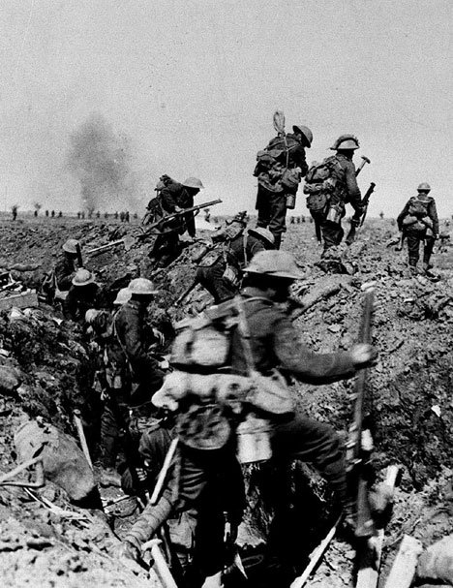

Slide 24
Nature of 20th Century War: War at Sea
Land armies seemed helpless and both sides looked to the sea:
The British impose a strict naval blockade, which divided good into two categories: contraband and noncontraband.
The British tried to stop all goods going to Germany in an attempt to starve out the enemy.
Neutral countries were not allowed to enter any German ports.

Slide 25
War at Sea continued..
Germany attempts to blockade Britain mainly through the use of submarines.
Britain seems helpless to submarine attacks at first.
Submarines were a new technology and it was hard to tell what kind of ship they were attacking.
The Lusitania is torpedoed off the Irish coast on May 7, 1915, killing 118 American citizens.

Slide 26
New Allies Needed
As the stalemate continued, countries begin to search for new allies:
In 1914, the Ottoman Empire and Bulgaria in 1915 join with Germany and Austria.
Both sides court Italy, the treaty of London promises Italy expanded territory.
Germany promises an independent Poland
In 1914, Japan declares war on Germany
In the crumbling Ottoman Empire, many groups hope for independence.

Slide 27
The Question of the United States
President Wilson is reelected in 1916 with the slogan “he kept us out of war”
Wilson could not see getting involved with either side, but he personally supported Britain and France.
He urged true neutrality, but the American people were divided.
Many people had been born in Europe or were children of immigrants
Several events lead to U.S. involvement….

Slide 28
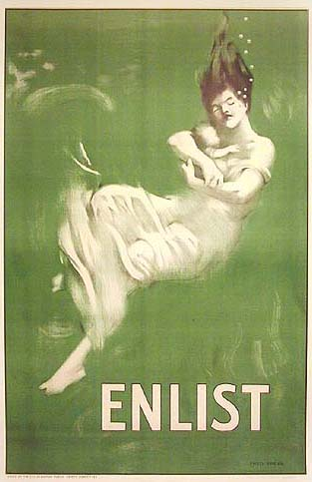

Slide 29
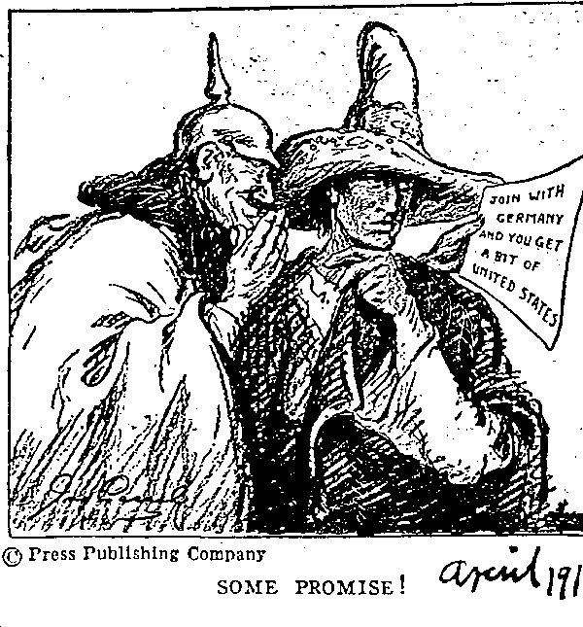

Slide 30
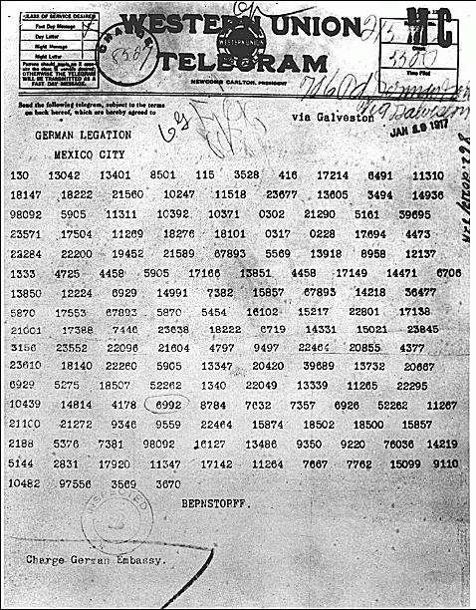

Slide 31
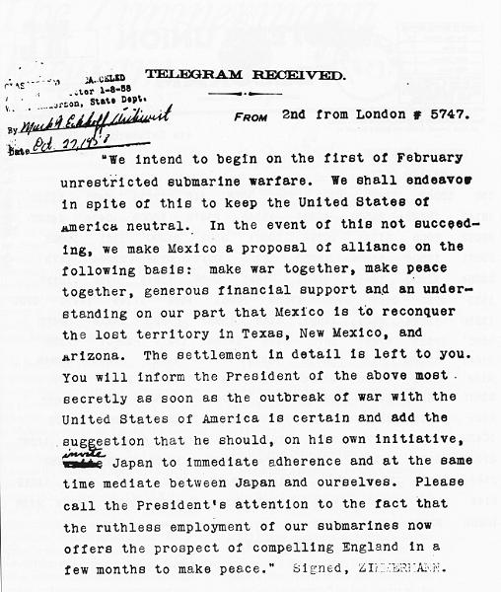

Slide 32
The United States goes to war
Germany announced unrestricted submarine warfare.
The Zimmerman telegram, January 16, 1917, convinces Americans of German aggressiveness.
On April 6, 1917 President Wilson went to Congress for a declaration of war- “to make the world safe for democracy”.

Slide 33
For you to consider:
Other technological developments in WWI.
What was happening on the home front during this time?
What was the role of women?

Slide 34
For Next Class
Answer questions to DISC source A and B.
Read Kissinger Article – Be prepared for discussion and a writing prompt.

Slide 35
Why do you think there has been so much disagreement among historians about the causes of the First World War?
What is the “doomsday machine” Kissinger refers to?
What is a total war, civil war, limited war, guerrilla war, and a revolutionary war?

