Slide 1
Chapter 6 Groups and Formal Organizations
Section 1
Primary and Secondary Groups

Slide 2
Journal
Make a list of 5 groups that you are emotionally and socially close to.
Think about why they are important to you.
For one group write a paragraph about the boundaries of that group:
Are others allowed in the group

Slide 3
Groups, Categories, and Aggregates
Group – at least two people who have one or more goals in common and share common ways of thinking and behaving.
Groups:
People are in regular contact with each other
Share some ways of thinking, feeling, behaving
Take on one another's behavior into account
Have one or more common interest or goals

Slide 4
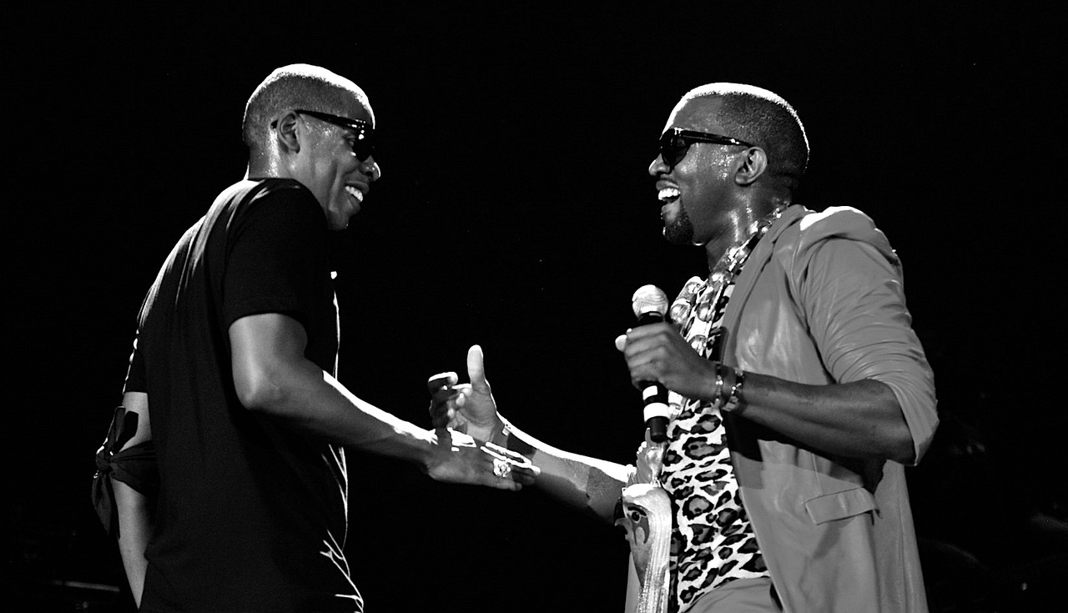
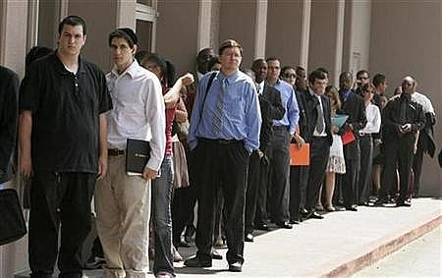
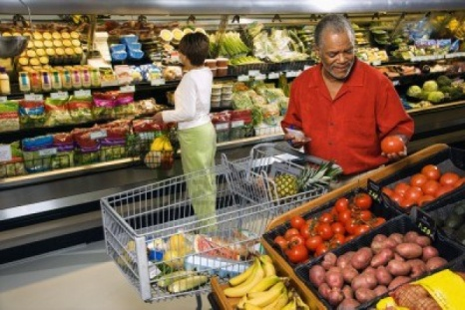
Social Category & Social Aggregate
Social Category – people who share a social characteristic
Social Aggregate – people who are temporarily in the same place at the same time
What are the main differences?

Slide 5
Primary Group
Primary Group – people who are emotionally close, know one another well, and seek one another’s company.
Primary Relationships – interactions that are intimate, personal, caring, and fulfilling.

Slide 6
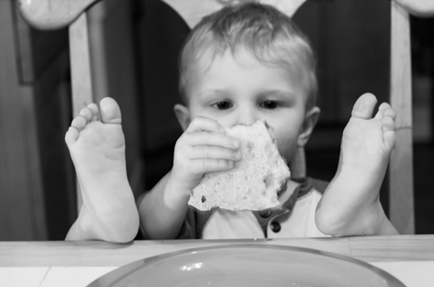
Primary Group Functions
Emotional Support
Socialization
Encourage Conformity

Slide 7
Group Work
Get into groups of three and create your own group.
Each group is to write down their groups function
Who is allowed in the group
Group must also design a logo
What should be turned into me:
Paper with name, functions, and member
Logo somewhere either on or attached.

Slide 8
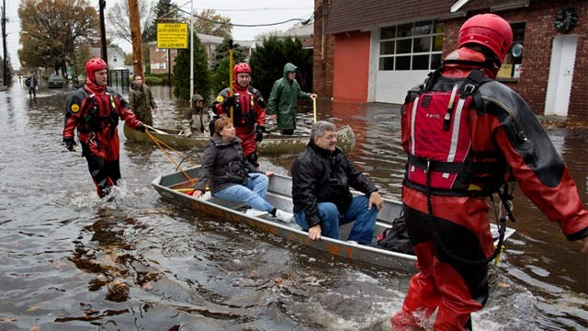
Secondary Groups
Secondary groups – people who share only part of their lives while focusing on a goal or task
Secondary relationships – impersonal interactions involving limited parts of personalities

Slide 9
Journal
Make a list of 5 groups that you are emotionally and socially close to.
Think about why they are important to you.
For one group write a paragraph about the boundaries of that group:
Are others allowed in the group
Which groups are harder to get into?
Primary or sencondary?

Slide 10
Assignment
Section 1 Vocab
Go to my website:
http://mrpatrickibhub.weebly.com/
Do vocab for section one
You can find it under sociology and chapter 6
Due at the beginning of next class

