Slide 1
Causes of WWII
Picking up where we left off.

Slide 2
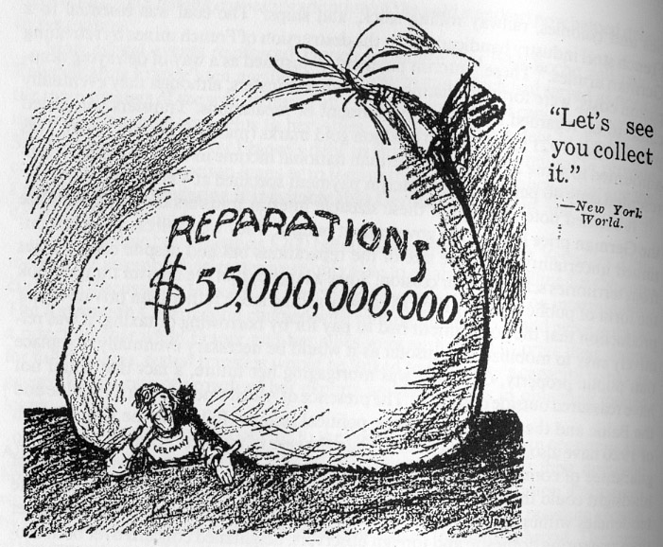
The Ruhr Crisis
France began to feel security was being under minded within a year of signing the Treaty Versailles.
German government seemed unlikely to elect a government to comply with treaty terms.
What were some of the terms for Germany?
Wiesbaden Accords – France agreed to take raw materials from Germany instead of money.

Slide 3
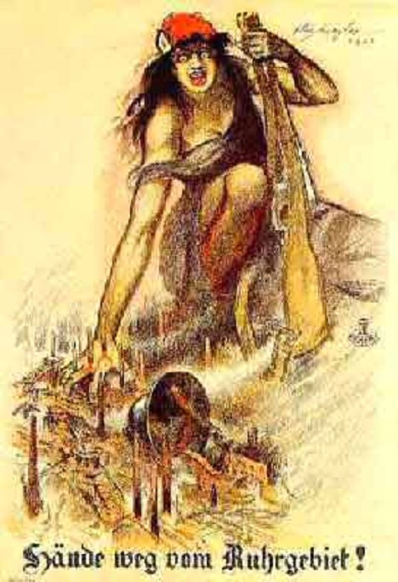
The Ruhr Crisis
Issue came to a head when Germany asked for payments to be suspended for four years.
January 1923 French and Belgium troops (with Italian aid) moved into Ruhr Valley.
French feared entire treaty would be void if suspended.
Germany repsonded with a strike.
Government decided to continue to pay striking workers.
To do so needed to print more money.
French answered with ‘passive resistance’
Did so by encouraging the unemployed of France and Belgium to work the Ruhr.

Slide 4
Impact of Crisis on German Economy
Value of British pound to German mark
Jan 1914 | 1 pound = 20 marks
Jan 1922 | 1 pound = 760 marks
Nov 1922 | 1 pound = 50,000 marks
Nov 1923 | 1 pound = 16,000,000,000 marks
Coal production in Ruhr
1922 | 90 million tons
Feb 1923 | 2.5 million tons
Operating iron smelting furnaces
1922 | 70
March 1923 | 3

Slide 6
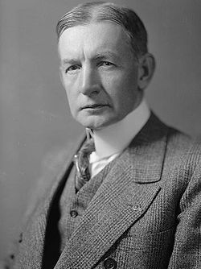
End of the crisis
Dawes Plan
Plan was named after US economist Charles Dawes
Dawes produced a report on German reparations that decided the following:
Reparations were guaranteed by two mortgages, one on German railways and the second on German industries (supplemented by taxation on the German population)
A US ‘reparation agent’ would reside in Germany to supervise payments.
Repayments were to be reduced.
Although reparations were reduced, France accepted plan because it brought the Americans back into the picture.
Once Germany agreed to the terms, French troops were withdrawn from the Ruhr.
Period became known as ‘the golden age of reparations’

Slide 7
Problems with the plan
Germans
Were unhappy that there was no fixed date for the reparations to end.
Britain and France
Concerned with the link between German payments and their own payment of war debts to the US

Slide 8
Results
What sort of impact would the Ruhr Crisis have on the LoN and why?

Slide 9
5 min break

Slide 10
The Rapallo Treaty
April 1922, German and Russian officials signed the treaty.
In the treaty:
Germany fully recognized the Soviet government
Both powers denounced reparations
Provided close economic cooperation
Military cooperation would now take place
Allowed Germany to rearm and train secretly in Russia.
Knowledge of the Rapallo Treaty made Great Britain more determined to win over Germany.
Pushed Germany to become even friendlier with Russia

Slide 11
Document Analysis
The invasion of the Ruhr in 1923 had the most serious consequences. Within Germany, it weakened the position of the middle classes in society and diminished their support for the Weimar government. Extremist parties on the right and the left were given a boost, because of the alarm at the prospect of complete economic collapse and social disorder. Many historians argue that the invasion of the Ruhr paved the way for Hitler’s subsequent rise to power. Both the British government and the British public were alienated by French policies…The French franc…came under pressure and the French government learned…. Direct action carried a high political cost…It has been suggested that France’s failure to take military action to stop Hitler’s remilitarization of the Rhineland in 1936 stemmed largely from the unhappy experience of the Ruhr in 1923.
From Ruth Henig, Origins of the First World War, 1993
Questions
According to Ruth Henig, what was the impact of the Ruhr Invasion on a) Germany and b) France?

Slide 12
HW/In Class Review
What were the reasons for the French occupation of the Ruhr, and how were their aims realized by this occupation?
What were the perspectives of other countries in this crisis.
How did France’s actions undermine the concept of collective security?

