Slide 1
5.2 5.3– Social Structure and Roles

Slide 2
Journal #22
What is status set and give me a list of ten that describes you.

Slide 3
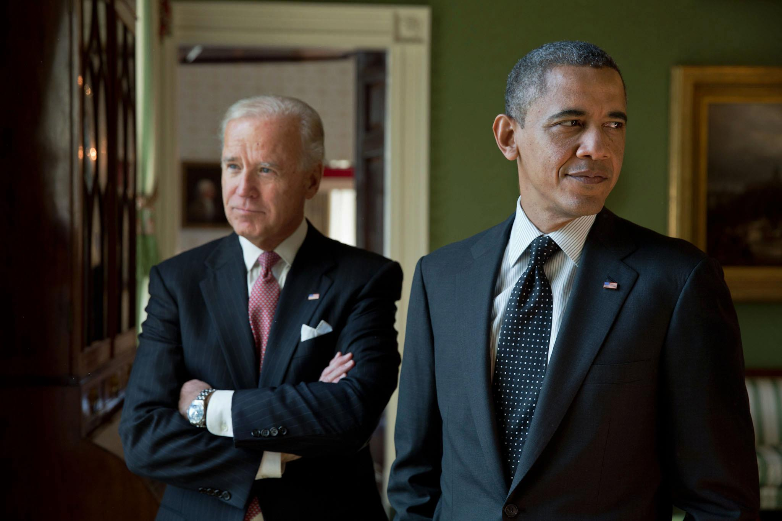

Slide 4


Slide 5
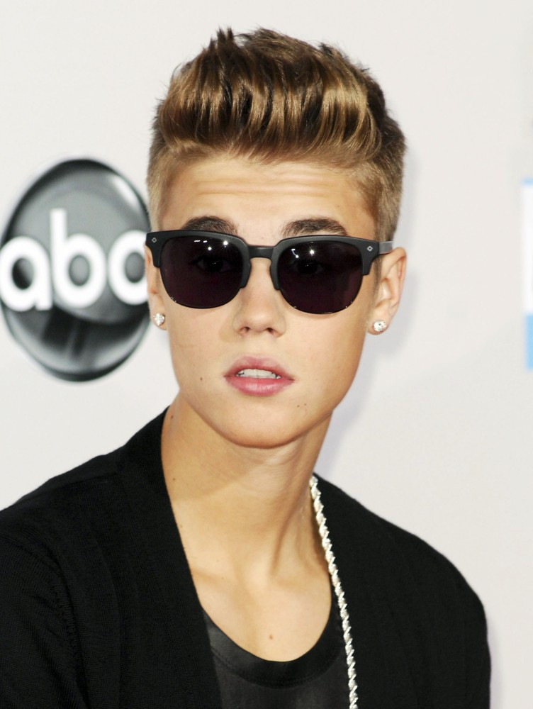
Role: Rights and Obligations
Role:
Expected behavior with a status
Rights:
Behavior that is expected from others
Obligations :
Behavior that you expect to perform for others.

Slide 6
Role Performance and Social Interaction
-Role Performance – the actual behavior of an individual in a role
-Social Interaction – the process of influencing each other as people relate.

Slide 7
Role Conflict and Role Strain
Role Conflict
One role interferes with another role
*Athlete and a student
Role Strain:
Trouble meeting the roles.
Example role conflict.

Slide 8
5.3: Preindsutrial Societies

Slide 9
Types of Society
Before we can list the types we must define society.
  Society- people living within a defined territorial borders and sharing common culture.

Slide 10
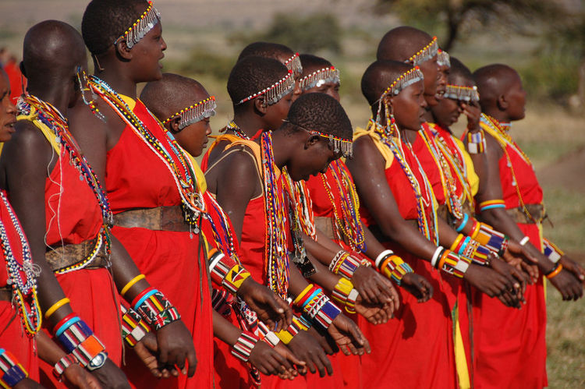

Slide 11
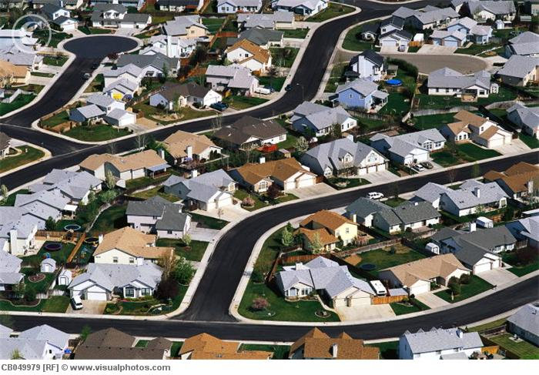

Slide 12
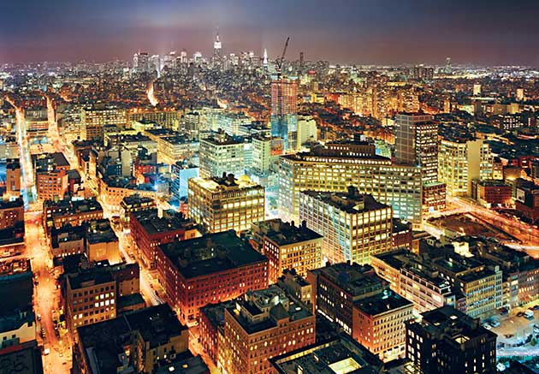

Slide 13
Group Activity – Groups
Group 1: Hunting/Gathering Society
Group 2: Horticultural Society
Group 3: Pastoral Society
Group 4: Agricultural Society
Present your item to class, and fill in timeline.

Slide 14
5.4: Industrial and Postindustrial Societies

Slide 15
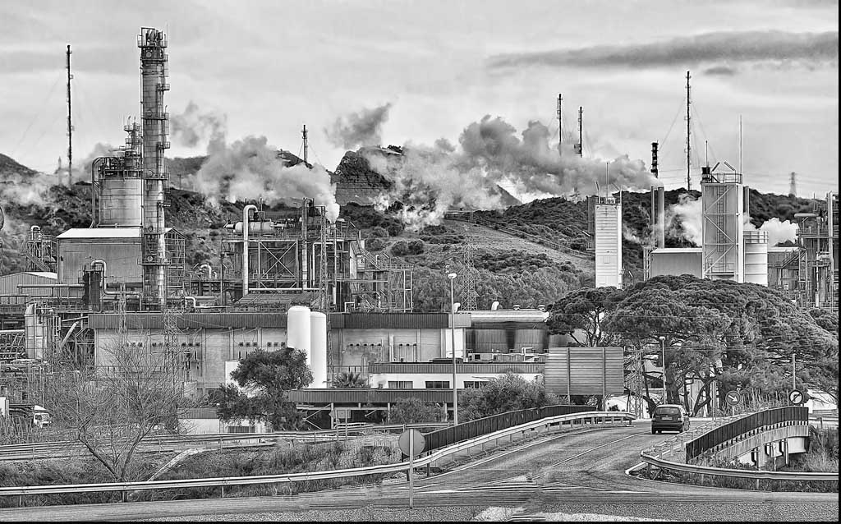
What is the Industrial Revolution (America)

Slide 16
Industrial Revolution
Science
Technology
To provide basic skills and services.

Slide 17
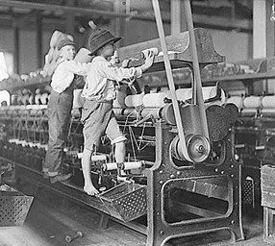
Industrial Revolution
When a society switches from agricultural to machine based.

Slide 18
Industrial Revolution
Mechanization:
Replacing animal labor with machines.
Urbanization:
People move from farms to cities.

Slide 19
Comparing Societies: Teen issues – How would teens handle each issue?
Group 1: Hunting Gathering – Curfew
Group 2: Horticultural – Dating
Group 3: Pastoral/Agricultural – grades
Group 4: Industrial – getting a job

Slide 20
Think, Pair, and Share
What do you think happens to the roles of the mom and father in industrial societies?

Slide 21
Ferdinand Tonnies vs Emile Durkheim’s view on industrial societies.
Tonnie:
Gemeinschaft
Gesselschaft
Durkheim:
Social Solidarity

Slide 22
What is Postindustrial Society? How does this differ from industrial society?

Slide 23
Postindustrial Society

Slide 24
Group Activity
World War 3 has just happened.
Technology is destroyed.
No food supply systems, transportation, medical care, education, and banking.
People are finding fruits/veggies, hunting, and searching for food.
No Social Classes.
You form a small community.
How are you going to survive? What roles will people have? Men? Women? Children?
How will you decide who does what? What will they do?

